Slide 1

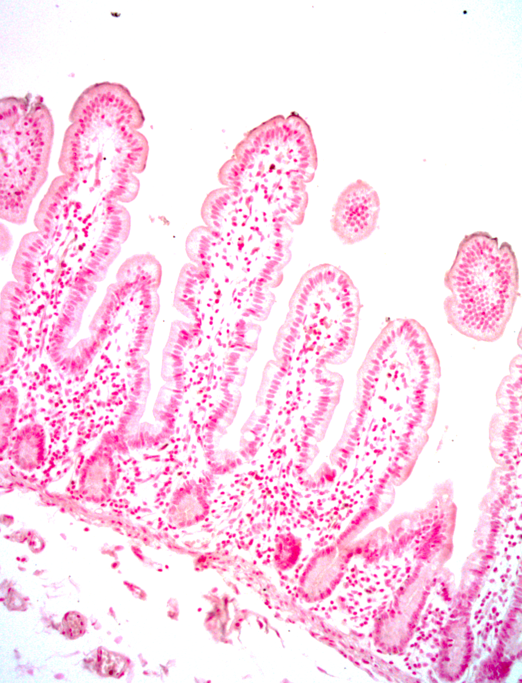
ReliaTech GmbH
Anti-human CEACAM-1 (#B3-17)
(Cat #101-M182)
Fig. 1: IHC staining of human jejunum tissue with mAb B3. CEACAM1 was detected in PFA-fixed paraffin-embedded sections of human jejunum tissue using mAb B3 followed by staining with anti-mouse HRP-DAB and counterstaining with hematoxylin. The labeling showed week staining of CEACAM1 by B3.
http://www.reliatech.de / orders@reliatech.de

